Slide 1

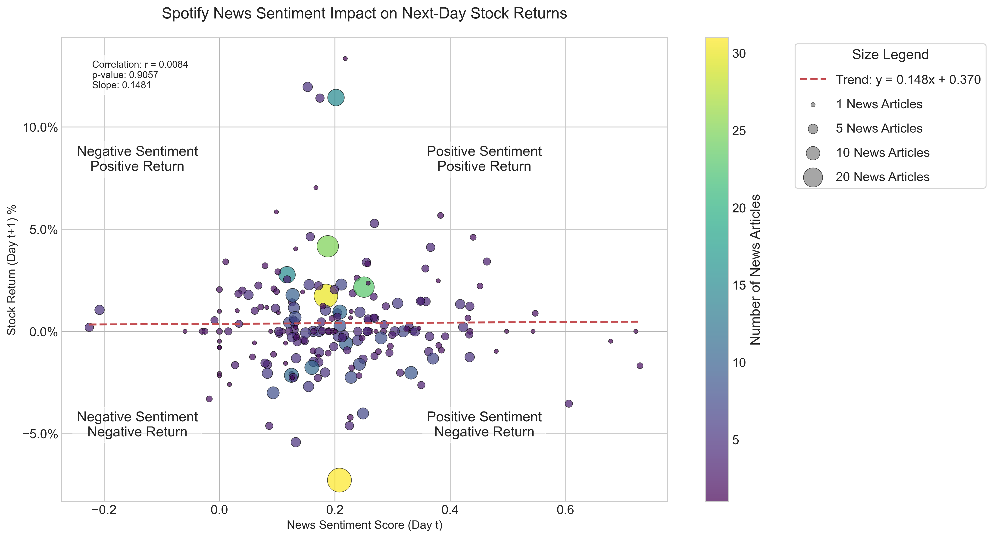
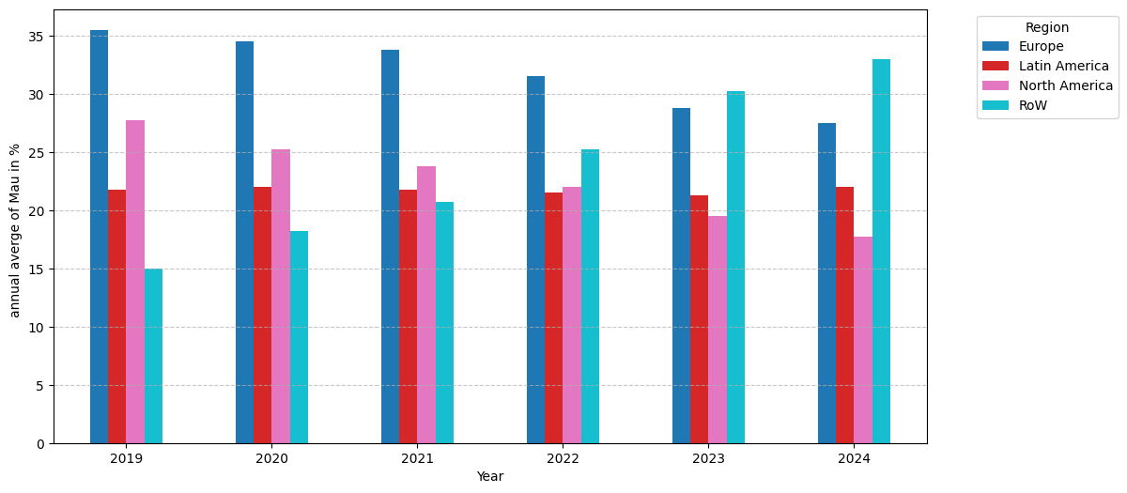


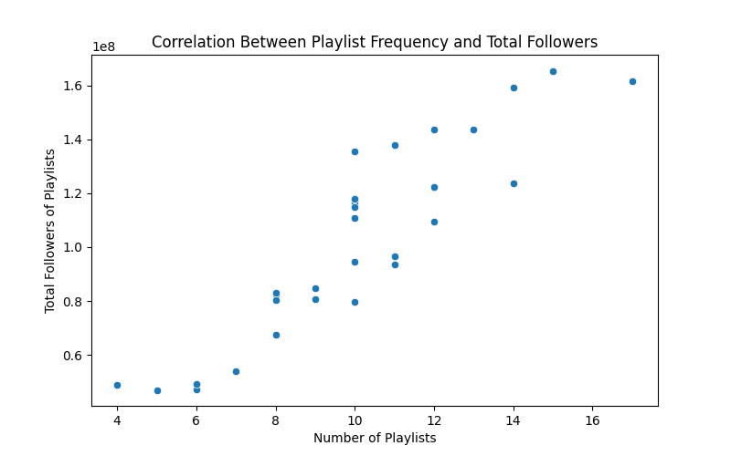
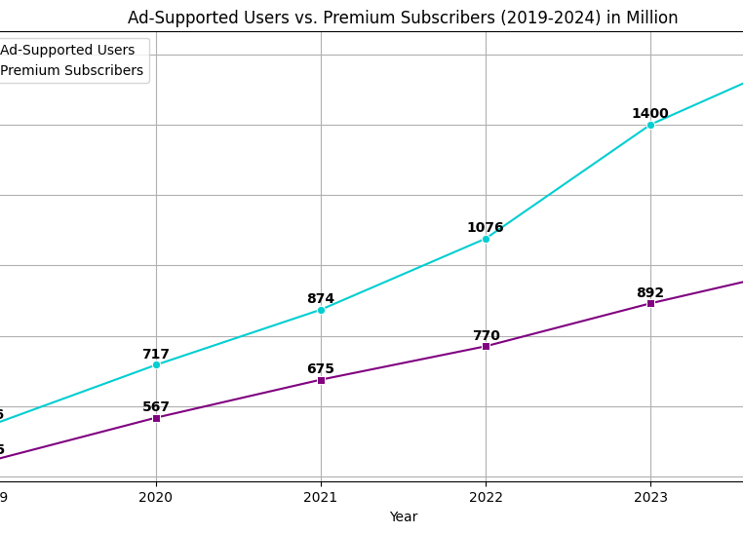



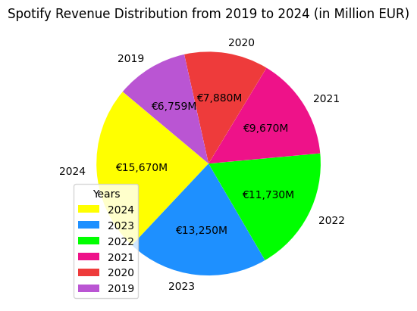
Spotify’s User Base: Stats, Growth & Trends Kira Schwarz, Sahand Hamed, Anahita Mesgarzadeh Tehrani, Armando Criscuolo
Introduction:
Spotify is a leading global music streaming platform with millions of monthly active users. This analysis examines the platform’s user growth over time, the impact of economic factors, and regional usage trends. Furthermore, it explores the balance between free and premium subscribers and the effects of pricing changes. Additionally, the study investigates trends in Spotify’s music charts to provide deeper insights into user behavior.
Finalize Questions
Look Sources
Gather Data
Filter Data
Clean Data
Visualize Data
Research Questions:
Filter & Clean
Data Visualization:
Suitable for a DS-Project
Sources:
Acceptable & publicly available
Data:
Fitting & various diagrams
Challenges:
Method:
RQ 2: Sentiment Analysis :
RQ 3: Global Regions :
How many users worldwide use Spotify monthly, and how has this number changed over time?
What does the sentiment analysis of news articles about Spotify reveal about the relationship between media coverage and stock performance?
Which global regions show the highest Spotify streaming activity, and how has this changed over time?
How does the ratio of free users (Free with ads) to premium subscribers impact Spotify’s revenue?
What demographic factors (e.g., age, gender) influence Spotify’s user base and subscription trends?
How do the popular music charts in general compare to the popular Spotify music charts?
How do price changes affect Spotify's growth?
Is there a tendency for popular tracks (Track Table) to appear more frequently in playlists (Playlist-Track Table)?
The scatter plot shows virtually no correlation (r = 0.0084, p-value = 0.9057) between Spotify news sentiment scores and next-day stock returns, with data points distributed across all four sentiment-return quadrants regardless of article volume (indicated by point size). This suggests that media coverage sentiment has negligible predictive power for Spotify's short-term stock performance
The bar chart shows the distribution of users across different regions over the years, representing the annual average of monthly active users (MAU) in percentage for each region.
RQ 8: Tendency of Tracks:
RQ 4: Ratio for Spotify’s Plans & Revenue :
The chart illustrates the growth of ad-supported users and premium subscribers from 2019 to 2024, measured in millions. While both categories show a steady increase, ad-supported users grow more rapidly, reaching 1608 million in 2024, compared to 1000 million premium subscribers.
This scatter plot illustrates a clear positive correlation: tracks that appear in more playlists tend to reach a higher total number of followers.
The pie chart combines ad-supported and premium revenues to show the overall revenue trends from 2019 to 2024.
Bibliography
QR CODE
OF THE WEBSITE
List the refences of the APIs, resources you used.
Add Github link as well.

